Slide 1
CPO Price Forecasting
Shahreedza Anissa Bin Mohd Saidi (2021488378)
Advance Time Series (STA768)

Slide 2
Table of contents
No | Contents
1 | Introduction
2 | Objectives
3 | Literature
4 | Methodology
5 | Results and Discussion
6 | Conclusion

Slide 3
Introduction
What is Crude Palm Oil?
Palm oil is a type of edible vegetable oil. It is also a fruit oil, like olive oil, because it is extracted from the mesocarp (flesh) of the oil palm’s fruits. In crude form, palm oil is semi-solid at room temperature and bright orange-red in color. This is due, respectively, to 50:50 unsaturated & saturated fatty acid composition of the oil and the presence of carotenes, which are abundant in the oil.
Today, palm oil is the leading commodity in the global oils and fats market. It has led the other competing vegetable oils and fats in terms of production, exports and consumption since 2005. This is mainly due to three factors associated with palm oil, which the competing oils and fats cannot match. These are abundant & uninterrupted supply all year long, versatility in food and non-food applications, as well as competitive trading prices.

Slide 4
More on Crude Palm Oil
Did you know CPO is traded as futures called FCPO?
FCPO is a Ringgit Malaysia (MYR) denominated Crude Palm Oil Futures Contract traded on Bursa Malaysia Derivatives, providing market participants a global price benchmark for the Crude Palm Oil Market since October 1980. For over 40 years, FCPO is actively used by edible oils and fats industry players as a risk management solution, as well as by fund managers and financial institutions for managing price fluctuations in the market.
Being actively traded on the futures market shows the demand for this commodity. Same goes to the instruments that are traded in the market. Price will move up and down. The highest price of FCPO recorded was on March last year trading at RM 8076 / ton. Currently it returned to normal position around RM 3/4 k per ton.

Slide 5
Research Questions
What model can forecast the CPO price reliably and accurately?
What is the best performing model with the lowest error to forecast the CPO price?
What is the best parameters for each models to ensure error is minimize in forecasting the CPO price?
Research Objectives
To compare the performance of each model in forecasting the CPO price.
To analyse the performance indicator to find the best model with the lowest error in forecasting the CPO price.
To analyse the data and conduct statistical test to find the best parameters for each model.

Slide 6



Collect data
MPOC (Malaysian Palm Oil Council)
EDA and Statistical Test
Visual plotting
Splitting data set
One-step ahead forecast
Stationarity
ACF and PACF
Fit model
AR
MA
ARMA
ARIMA
Evaluate performance
MAPE
RMSE
Decide the best model
Compare performance
80/20
85/15
90/10
95/5
Methodology
Obj 3
Obj 2
Obj 1

Slide 7
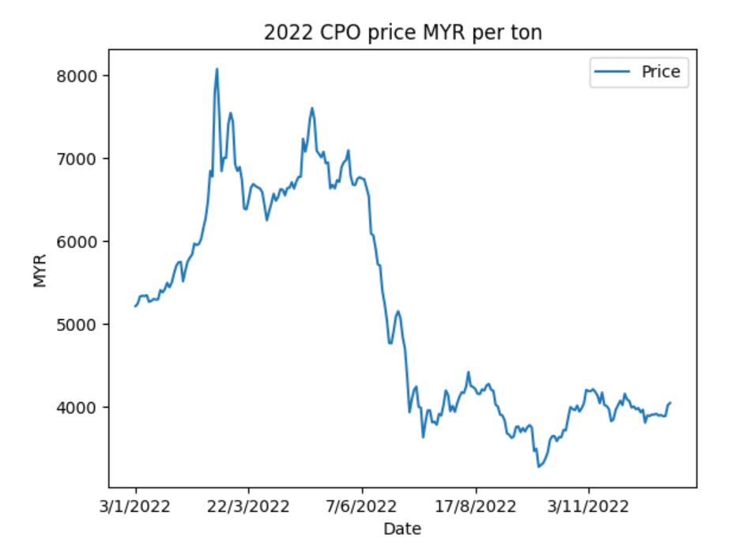
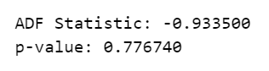
Explanatory Data Analysis
The CPO price was unstable from the year 2022.
We can say for the first half of the year, the average price would be around RM6500 and for the second half around RM4000.
That is almost 50% of change in a single year.
Failed to reject h-null since p-value higher than significance level. Therefore, the original series is not stationary.
Local and global test also shows the original series is not stationary.

Slide 8
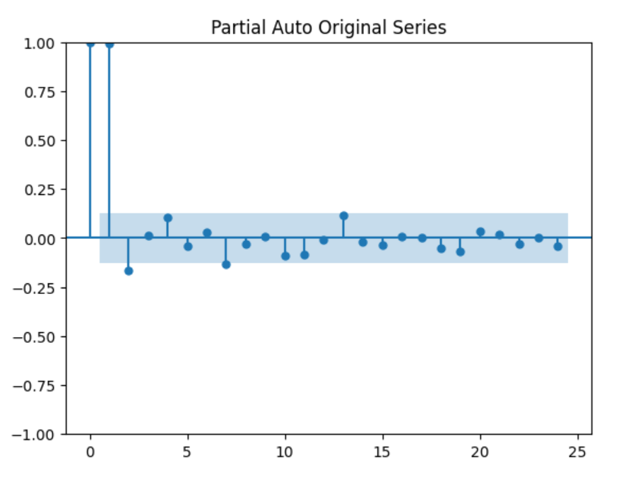
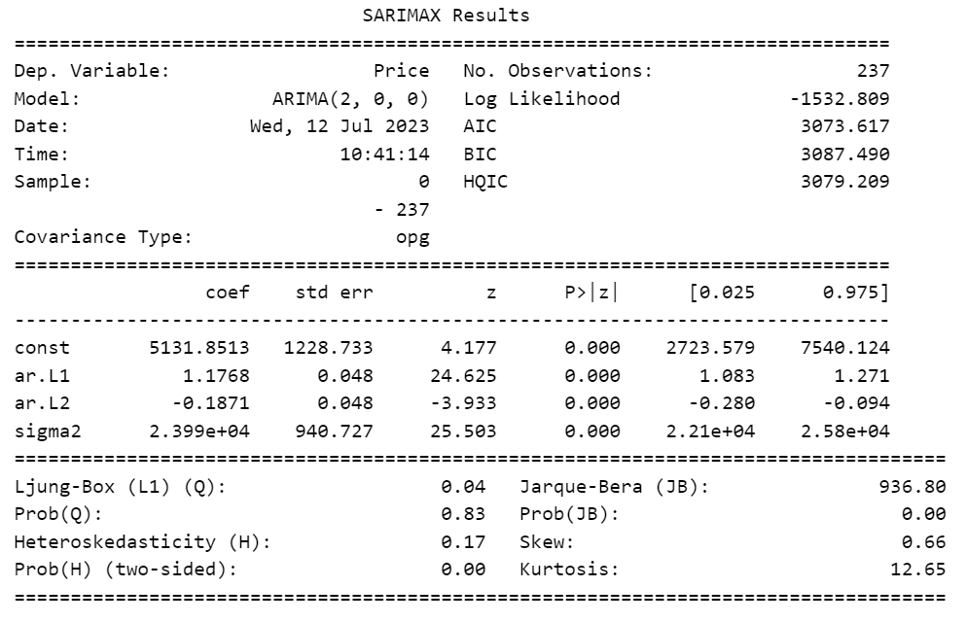
AR (Autoregressive)
The PACF plot shows the series are correlated with lag 1 and 2. Lag 1 and 2 can be used to coefficients of the model.
The p-values of AR(2) is lower than the significance level of 5%. Therefore, the AR(2) model is acceptable.

Slide 9
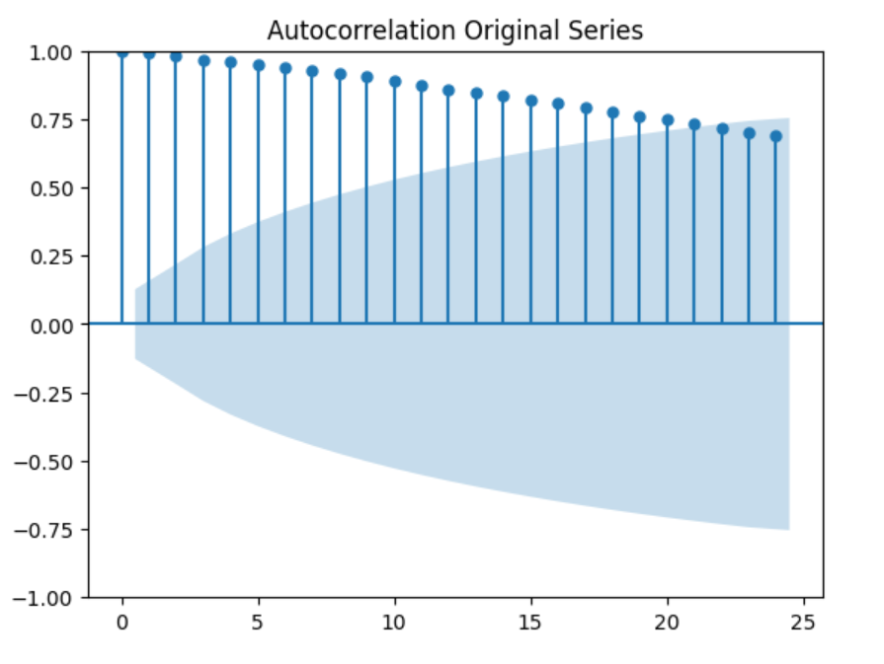
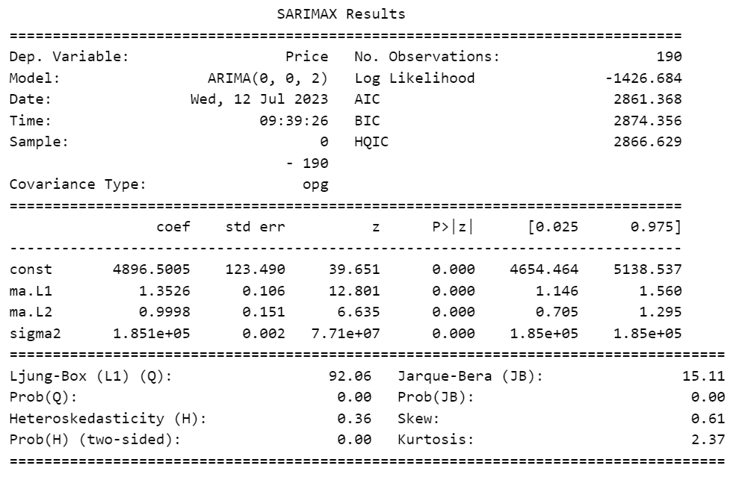
MA (Moving Average)
The ACF plot shows the series are correlated with lag 1 to lag 20. Lag 1 to lag 20 can be used to coefficients of the model.
The p-values of MA(2) is lower than the significance level of 5%. Therefore, the MA(2) model is acceptable.

Slide 10
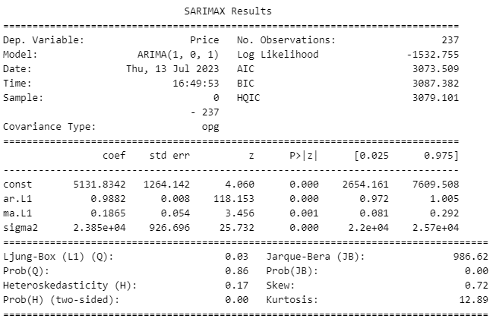
ARMA (Autoregressive Moving Average)
The ACF plot shows the series are correlated with lag 1 to lag 20. Lag 1 to lag 20 can be used to coefficients of the model. Meanwhile, The PACF plot shows the series are correlated with lag 1 and 2. Lag 1 and 2 can be used to coefficients of the model.
The p-values of MA(1) is lower than the significance level of 5%. The MA(1) coefficient is acceptable. The p-values of AR(2) is lower than the significance level of 5%. The AR(2) coefficient is acceptable. Therefore, the ARMA model is ARMA(2,2)

Slide 11
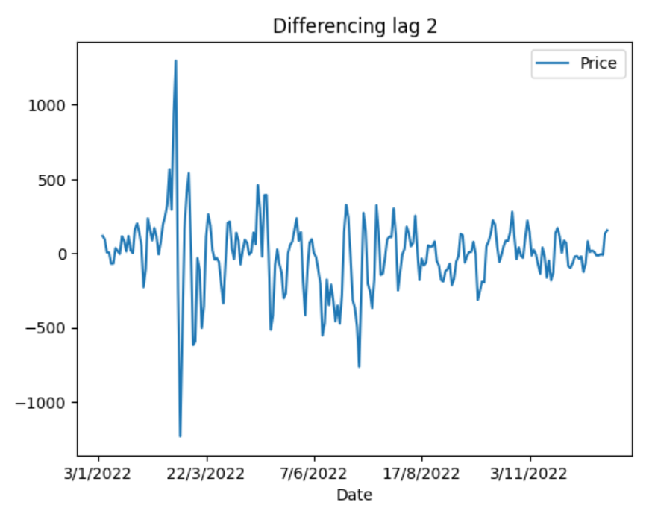
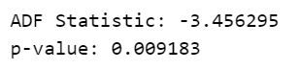
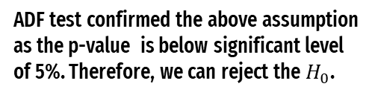
ARIMA (Autoregressive Integrated Moving Average)
Differencing of lag 2 shows the series can be assumed to be stationary with local and global test.
ADF test confirmed the above assumption as the p-value is below significant level of 5%. Therefore, we can reject the $H_{0}$.

Slide 12
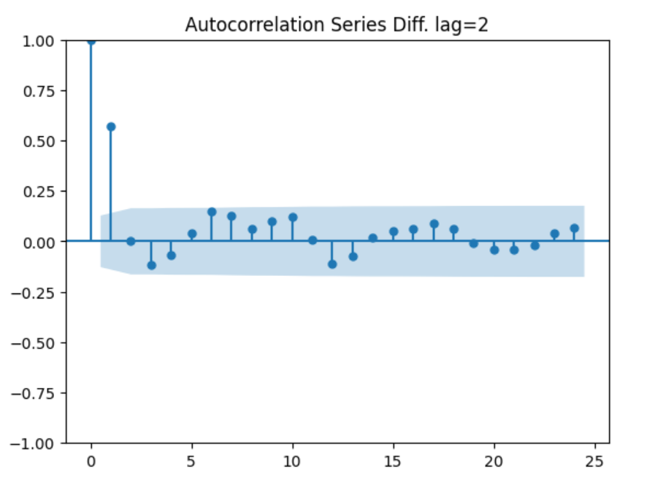
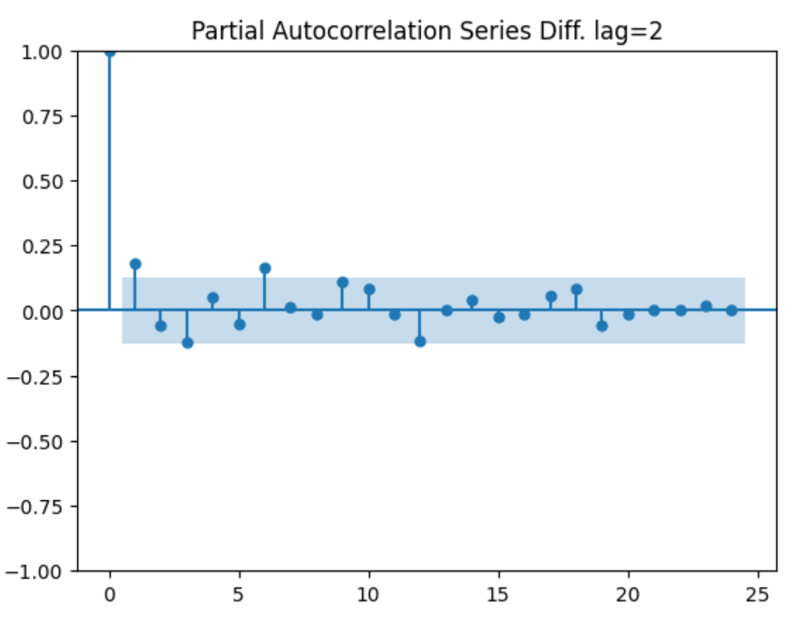
ARIMA (Autoregressive Integrated Moving Average)
The differed series show correlation at lag 1. The MA model will be MA(1).
The differed series show correlation at lag 1 and 6. The AR model will be AR(1) or AR(6).

Slide 13
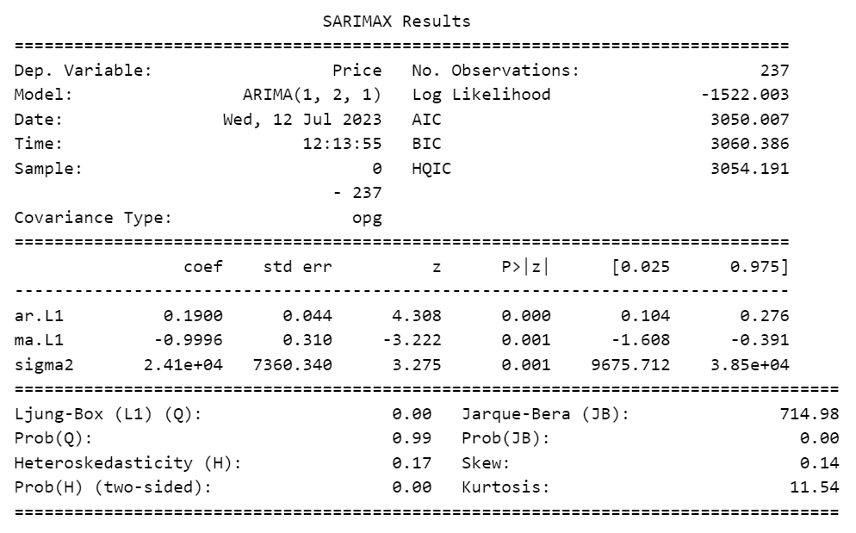
ARIMA (Autoregressive Integrated Moving Average)
P-value of the coefficients is statistically significant as it is lower than p-value. Therefore, the ARIMA model is ARMA(1,2,1) is acceptable.

Slide 14
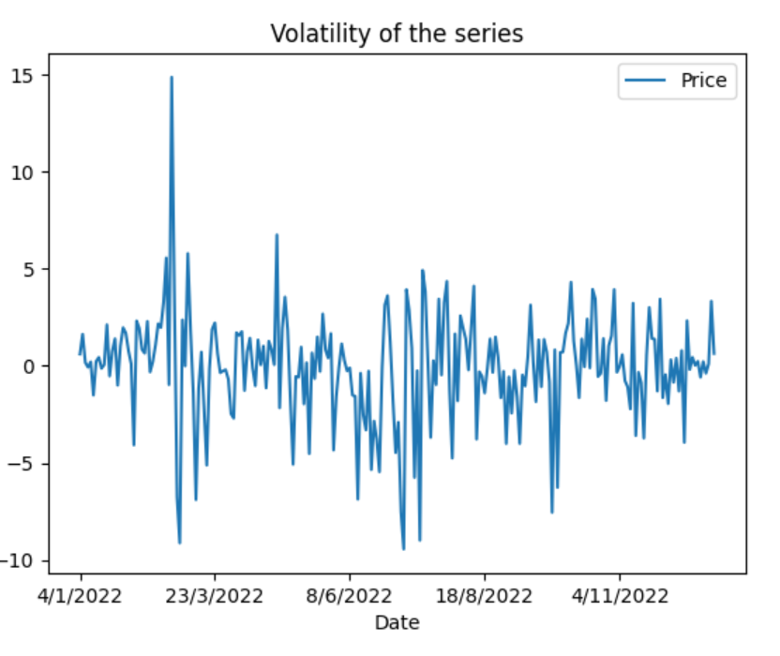
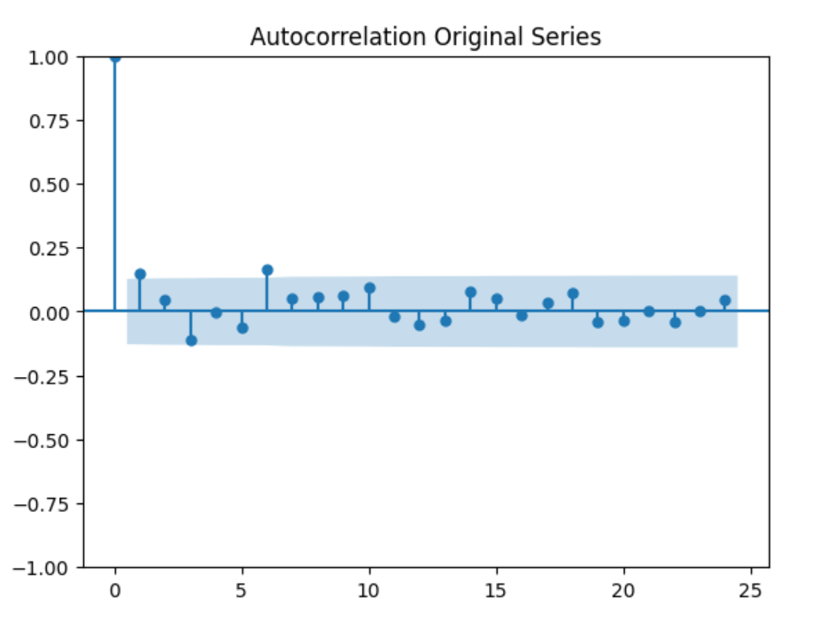
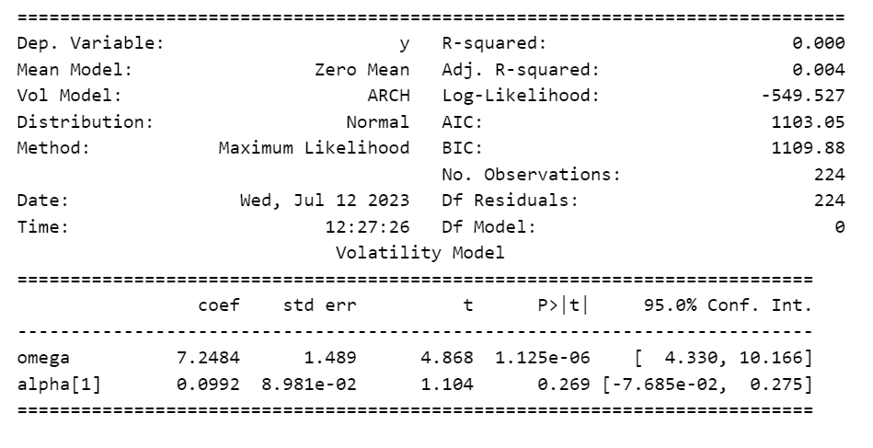
ARCH (Autoregressive Conditional Heteroskedasticity)
The series is very volatile, as for the first quarter alone a change up to 15% occurred.
The series is correlated with lag 1 and 6.
ARCH(1) p-value is lower than the significant level. ARCH(1) is acceptable.

Slide 15
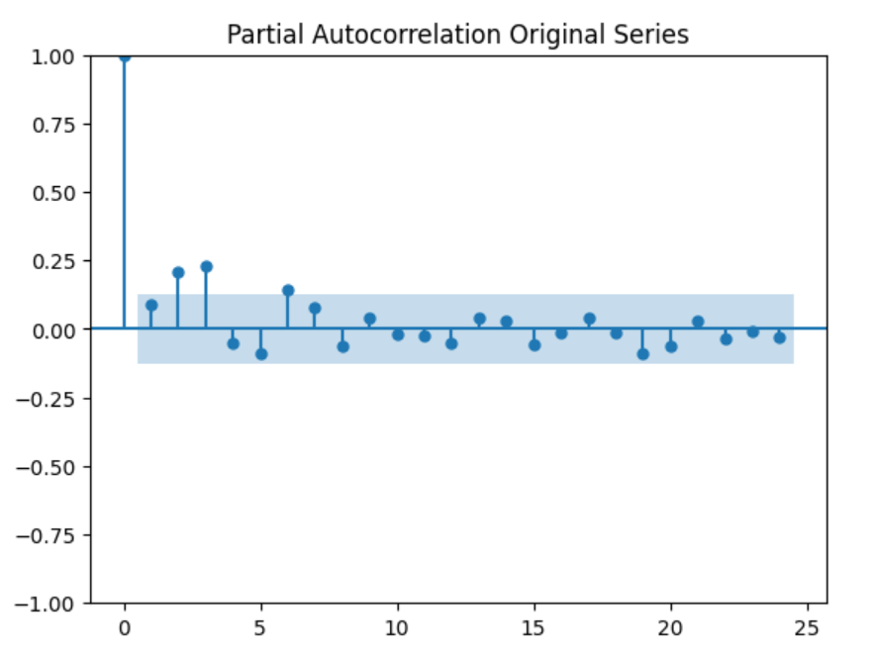
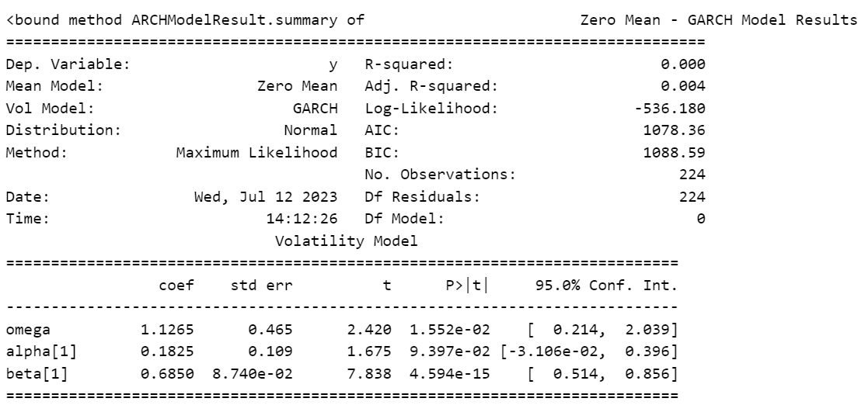
GARCH (Generalized Autoregressive Conditional Heteroskedasticity)
The series is partially-correlated with lag 2 and 3.
Further model fitting shows that GARCH(1,1) results in the coefficient being significant (p-value< 5%)

Slide 16
Model performance comparison
RMSE (Root Mean Square Error)
 | AR |  | MA |  | ARMA |  | ARIMA
80 | 172.44 | 231.88 | 470.81 | 1417.52 | 168.75 | 315.26 | 171.26 | 435.65
85 | 168.3 | 437.6 | 488.06 | 1338.61 | 164.7 | 489.45 | 167.62 | 139.48
90 | 164.62 | 203.19 | 484.36 | 1281.45 | 161.3 | 261.76 | 164.2 | 80.17
95 | 160.75 | 139.4 | 598.56 | 1237.35 | 157.66 | 167.85 | 160.41 | 76.46
Weighted error | 166.2507 | 249.3614 | 513.1586 | 1314.463 | 162.8406 | 303.7949 | 165.6156 | 174.8194
The error is calculated with one-step ahead forecast, with increment of 5% of the training size. The weighted average of error(RMSE), of each model derive the final results
However, we can see from the table the training error of ARMA is the lowest, but the testing value is higher than the training. This indicate a problem with overfitting the data.
Therefore, ARIMA is the best model for this case.

Slide 17
Appendix

Slide 18
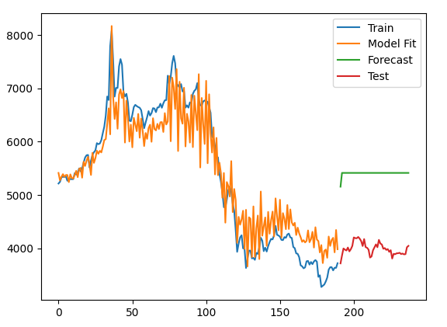
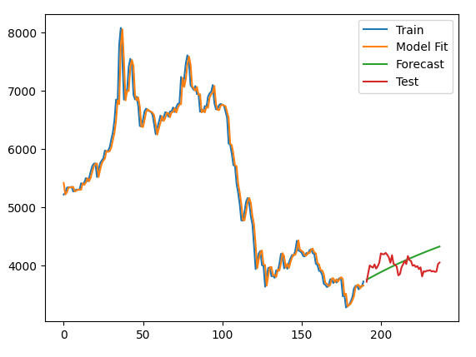
MA(2)
AR(1)

Slide 19
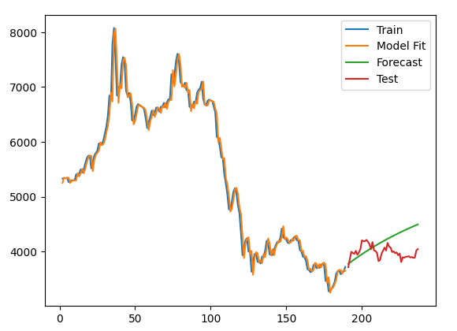
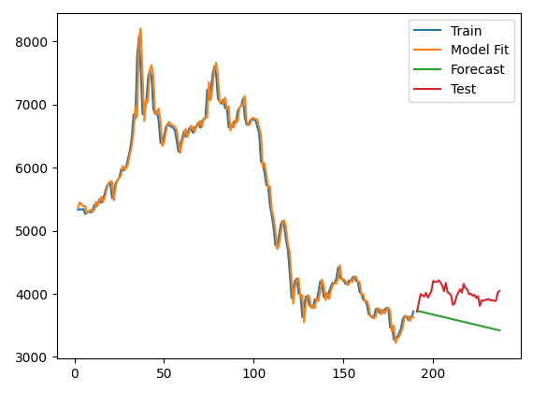
ARMA(1,1)
ARIMA(1,2,1)

Slide 20
Data Charts Infographics
Venus
Mars
Saturn
90%
75%
60%
70%
40%
85%
80%
100%
60%
2020
2021
2022
Venus is the second planet from Sun
Mars is a cold place full of iron oxide dust
Saturn is a gas giant and has several rings

Slide 21
Data Charts Infographics
1000
900
Product 1
800
Venus is the second planet from the Sun
700
600
500
400
Product 2
300
Saturn is composed of hydrogen and helium
200
100
2020
2021
2022
2023
2024

Slide 22
Data Charts Infographics
Saturn
Venus
Jupiter
+90
Venus has a nice name and is the second planet from the Sun
Mars
+80
Earth
+70
Venus
+60
Saturn
+50
Saturn is the ringed planet, composed of hydrogen and helium
Mars
Despite being red, Mars is a cold planet full of iron oxide dust

Slide 23
Data Charts Infographics
80%
90%
10%
60%
70%
50%
2020
2021
2022
2023
2024
2025

Slide 24
Data Charts Infographics
150€
100€
100€
70€
Quarter 1
Quarter 2
Quarter 3
Quarter 4
Venus has a nice name
Mars is a cold place
Jupiter is the biggest planet
Saturn has several rings

Slide 25
Data Charts Infographics
Mercury is the smallest planet
Mercury
100%
Venus has a beautiful name
Venus
50%
Earth
60%
Earth in the only planet with life
Mars is actually a cold place
Mars
30%
Saturn is a gas giant and has rings
Saturn
80%

Slide 26
Data Charts Infographics
Mars
60%
Despite being red, Mars is actually a cold place full of iron oxide dust
Venus
80%
Venus has a beautiful name, but it’s terribly hot, even hotter than Mercury
Neptune
50%
Neptune is the fourth-largest planet by diameter in the Solar System

Slide 27
Data Charts Infographics
100%
60%
90%
80%
Venus
Mars
Mercury
Saturn
Venus has a beautiful name
Mars is actually a cold place
Mercury is the smallest planet
Saturn is a gas giant and has rings

Slide 28
Data Charts Infographics
Product 1
Product 2
Venus has a beautiful name and is the second planet from the Sun
Despite being red, Mars is a cold place full of iron oxide dust
Product 3
Product 4
Mercury is the closest planet to the Sun and the smallest one
Jupiter is a gas giant and the biggest planet in the Solar System

Slide 29
Data Charts Infographics
75%
50%
30%
80%
Saturn
Mercury
Mars
Jupiter
It’s composed of hydrogen and helium
Mercury is the closest planet to the Sun
Despite being red, Mars is a cold place
Jupiter is a gas giant and the biggest planet

Slide 30
Data Charts Infographics
Quarter 1
Quarter 2
15%
Venus has a beautiful name and is the second planet from the Sun
Despite being red, Mars is a cold place full of iron oxide dust
15%
25%
Quarter 3
Quarter 4
35%
Mercury is the closest planet to the Sun and the smallest one
Jupiter is a gas giant and the biggest planet in the Solar System

Slide 31
Data Charts Infographics
Venus
50%
Mars
Venus has a beautiful name and is the second planet from the Sun
Despite being red, Mars is a cold place full of iron oxide dust
35%
10%
Mercury
Jupiter
Mercury is the closest planet to the Sun and the smallest one
15%
Jupiter is a gas giant and the biggest planet in the Solar System

Slide 32
Data Charts Infographics
Venus
75%
Venus has a beautiful name and is the second planet from the Sun
65%
50%
Jupiter
Jupiter is a gas giant and the biggest planet in the Solar System
Mercury
Mercury is the closest planet to the Sun and the smallest of them all

Slide 33
Data Charts Infographics
50%
60%
Venus
Mars
Venus has a beautiful name and is the second planet from the Sun
Despite being red, Mars is a cold place full of iron oxide dust
70%
80%
Mercury
Jupiter
Mercury is the closest planet to the Sun and the smallest one
Jupiter is a gas giant and the biggest planet in the Solar System

Slide 34
Data Charts Infographics
Venus
Venus has a beautiful name and is the second planet from the Sun
80%
Jupiter
Jupiter is a gas giant and the biggest planet in the Solar System
70%
Mercury
55%
Mercury is the closest planet to the Sun and the smallest of them all

Slide 35
Data Charts Infographics
Venus
Mars
Venus has a beautiful name and is the second planet from the Sun
Despite being red, Mars is a cold place full of iron oxide dust
Mercury
Jupiter
Mercury is the closest planet to the Sun and the smallest one
Jupiter is a gas giant and the biggest planet in the Solar System

Slide 36
Data Charts Infographics
Mercury
5/10
Mercury is the closest to the Sun
Venus
8/10
Venus is the second planet from the Sun
Earth
4/10
Planet Earth is the only one with life
Mars
7/10
Mars is a cold place full of iron oxide dust

Slide 37
Data Charts Infographics
January
Project 1
Project 2
February
Project 3
March
Project 4
April
May
Planet Venus
Venus has a beautiful name and is the second planet from the Sun. It is terribly hot, even hotter than Mercury
June
0
10
15
20
25
30

Slide 38
Data Charts Infographics
71+
70
60
50
40
30
20
100%
75%
50%
25%
0%
25%
50%
75%
100%
Male
Female

Slide 39
Data Charts Infographics
Mercury
Venus
Earth
Mars
Jupiter
Saturn
JAN
FEB
MAR
APR
MAY
JUN
JUL
AUG
SEP
OCT
NOV
DEC

Slide 40
Data Charts Infographics
Venus
Venus has a beautiful name and is the second planet from the Sun
9,000
Mercury
Mercury is the closest planet to the Sun and the smallest one
5,000
Mars
Despite being red, Mars is a cold place full of iron oxide dust
4,000
Jupiter
Jupiter is a gas giant and the biggest planet in the Solar System
8,000

Slide 41
Data Charts Infographics
400
400
200
Mercury
Q4
Mercury is the smallest planet
600
100
300
Q3
Venus
200
300
500
Venus is the second planet from the Sun
Q2
300
500
200
Q1
Earth
Earth is the only planet with life
100
300
500
700
900

Slide 42
Data Charts Infographics
+50
Losses
+40
+30
Mercury is the closest planet to the Sun and the smallest one
+20
+10
Profits
-10
-20
Venus has a beautiful name and is the second planet from the Sun
-30
-40
-50

Slide 43
Data Charts Infographics
1000
200
1000
900
800
400
700
600
500
400
100
300
300
200
100
0
Venus
Mars
Jupiter
Saturn
Earth
Venus has a beautiful name
Mars is a cold place
Jupiter is the biggest planet
Saturn has several rings
Earth is the planet with life

Slide 44
Data Charts Infographics
Product 1
Product 2
1000
900
800
700
600
500
400
300
200
100
Jan
Feb
Mar
Apr
May
Jun
Jul
Aug
Sep
Oct
Nov
Dec

Slide 45
Data Charts Infographics
Result 1
500
Venus is the second planet from the Sun
400
Result 2
300
Saturn is composed of hydrogen and helium
200
Result 3
100
Mars is a cold planet full of iron oxide dust
Item 1
Item 2
Item 3
Item 4

Slide 46
Data Charts Infographics
Jan
Feb
Mar
Apr
May
Jun
Jul
Aug
Sep
Oct
Nov
Dec
Product 1
Product 2

Slide 47
Data Charts Infographics
50M
Product 1
Venus is the second planet from the Sun
40M
30M
Product 2
Saturn is composed of hydrogen and helium
20M
10M
Product 3
Mars is a cold planet full of iron oxide dust
Q1
Q2
Q3
Q4

Slide 48
Data Charts Infographics
100
50
60
70
90
40
Mercury
Venus
Earth
Mars
Jupiter
Saturn

Slide 49
Data Charts Infographics
$5000
$4000
$3000
$2000
$1000
Item 1
Item 2
Item 3
Item 4
Item 5

Slide 50
Instructions for use (free users)
In order to use this template, you must credit Slidesgo by keeping the Thanks slide.
You are allowed to:
Modify this template.
Use it for both personal and commercial purposes.
You are not allowed to:
Sublicense, sell or rent any of Slidesgo Content (or a modified version of Slidesgo Content).
Distribute this Slidesgo Template (or a modified version of this Slidesgo Template) or include it in a database or in any other product or service that offers downloadable images, icons or presentations that may be subject to distribution or resale.
Use any of the elements that are part of this Slidesgo Template in an isolated and separated way from this Template.
Delete the “Thanks” or “Credits” slide.
Register any of the elements that are part of this template as a trademark or logo, or register it as a work in an intellectual property registry or similar.
For more information about editing slides, please read our FAQs or visit Slidesgo School:
https://slidesgo.com/faqs and https://slidesgo.com/slidesgo-school

Slide 51
Instructions for use (premium users)
In order to use this template, you must be a Premium user on Slidesgo.
You are allowed to:
Modify this template.
Use it for both personal and commercial purposes.
Hide or delete the “Thanks” slide and the mention to Slidesgo in the credits.
Share this template in an editable format with people who are not part of your team.
You are not allowed to:
Sublicense, sell or rent this Slidesgo Template (or a modified version of this Slidesgo Template).
Distribute this Slidesgo Template (or a modified version of this Slidesgo Template) or include it in a database or in any other product or service that offers downloadable images, icons or presentations that may be subject to distribution or resale.
Use any of the elements that are part of this Slidesgo Template in an isolated and separated way from this Template.
Register any of the elements that are part of this template as a trademark or logo, or register it as a work in an intellectual property registry or similar.
For more information about editing slides, please read our FAQs or visit Slidesgo School:
https://slidesgo.com/faqs and https://slidesgo.com/slidesgo-school

Slide 52
Infographics
You can add and edit some infographics to your presentation to present your data in a visual way.
Choose your favourite infographic and insert it in your presentation using Ctrl C + Ctrl V or Cmd C + Cmd V in Mac.
Select one of the parts and ungroup it by right-clicking and choosing “Ungroup”.
Change the color by clicking on the paint bucket.
Then resize the element by clicking and dragging one of the square-shaped points of its bounding box (the cursor should look like a double-headed arrow). Remember to hold Shift while dragging to keep the proportions.
Group the elements again by selecting them, right-clicking and choosing “Group”.
Repeat the steps above with the other parts and when you’re done editing, copy the end result and paste it into your presentation.
Remember to choose the “Keep source formatting” option so that it keeps the design. For more info, please visit Slidesgo School.

